Slide 1
Software Engineering – Data Flow Diagram
By
Dr. Junaid Akram
Assistant Professor, Department Of Computer Science Comsats (Lahore)

Slide 2
Data Flow Diagrams
DFD graphically representing:
the functions, or processes,
which capture, manipulate, store, and distribute data
between a system and its environment and between components of a system.
The visual representation makes it a good communication tool between User and System designer.
Structure of DFD allows starting from a broad overview and expand it to a hierarchy of detailed diagrams (other levels).

Slide 3
Data Flow Diagrams (contd.)
DFD has often been used due to the following reasons:
Logical information flow of the system
Determination of physical system construction requirements
Simplicity of notation
Establishment of manual and automated systems requirements

Slide 4
DFD Notation
External Entities → Oval Shape
Processes → Rounded corner rectangles, which contains the process number, the responsibility, and the process name (has to start with a verb)
Data Stores → Open right side rectangle, which contains the data store ID and the data store name
Note: Each Data store is an entity in the ERD
The Arrows → represent the flow of data

Slide 5
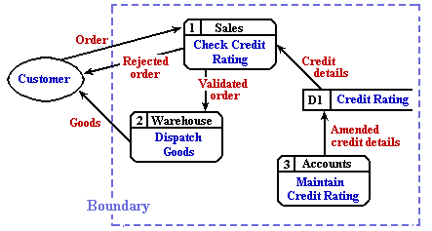
DFD Notation and Example

Slide 6
DFD Levelling
Context-Level Level 0 Level 1 Level 2
2
2.2
Entity
1
2.1
2.2.1
Process
sub
Process
sub-sub
Process
Overall
process
2
2.2
2.2.2
sub
Process
sub-sub
Process
Process
3
2.3
2.2.3
Entity
sub
Process
sub-sub
Process
Process

Slide 7
General DFD Rules
YES
NO
A process to another process
A process to an external entity
A process to a data store
An external entity to another external entity
An external entity to a data store
A data store to another data store

Slide 8
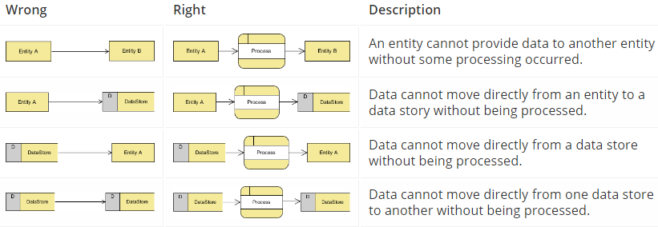
DFD Rules

Slide 9
DFD Case Study

Slide 10
Creating Data Flow Diagrams
Example
Steps:
The operations of a simple lemonade stand will be used to demonstrate the creation of dataflow diagrams.
Create a list of activities
Old way: no Use-Case Diagram
New way: use Use-Case Diagram
Construct Context Level DFD (identifies sources and sink)
Construct Level 0 DFD (identifies manageable sub processes )
Construct Level 1- n DFD (identifies actual data flows and data stores )

Slide 11
Creating Data Flow Diagrams
Example
Create a list of activities
Think through the activities that take place at a lemonade stand.
Customer Order
Serve Product
Collect Payment
Produce Product
Store Product

Slide 12
Creating Data Flow Diagrams
Example
Create a list of activities
Also think of the additional activities needed to support the basic activities.
Customer Order
Serve Product
Collect Payment
Produce Product
Store Product
....
Order Raw Materials
Pay for Raw Materials
Pay for Labor

Slide 13
Creating Data Flow Diagrams
Example
Create a list of activities
Group these activities in some logical fashion, possibly functional areas.
Customer Order
Serve Product
Collect Payment
...
Produce Product
Store Product
...
Order Raw Materials
Pay for Raw Materials
....
Pay for Labor

Slide 14
Creating Data Flow Diagrams
Example
Construct Context Level DFD (identifies sources and sink)
Create a context level diagram identifying the sources and sinks (users).
Context Level DFD
Customer Order
Serve Product
Collect Payment
Produce Product
Store Product
Order Raw Materials
Pay for Raw Materials
Pay for Labor
CUSTOMER
Order
0.0
Lemonade System
Sales Forecast
EMPLOYEE
Product Served
Production Schedule
Pay
Payment
Time Worked
Received Goods
Payment
Purchase Order
VENDOR

Slide 15
Creating Data Flow Diagrams
Example
Construct Level 0 DFD (identifies manageable sub processes )
Create a level 0 diagram identifying the logical subsystems that may exist.
Level 0 DFD
1.0
Sale
Customer Order
Serve Product
Collect Payment
Produce Product
Store Product
Order Raw Materials
Pay for Raw Materials
Pay for Labor
Customer Order
Sales Forecast
Product Ordered
CUSTOMER
Payment
2.0
Production
EMPLOYEE
Product Served
Production Schedule
Received Goods
Inventory
VENDOR
3.0
Procure-ment
Purchase Order
Order Decisions
Payment
Pay
Time Worked
4.0
Payroll

Slide 16

Creating Data Flow Diagrams
Example
Construct Level 1- n DFD (identifies actual data flows and data stores )
Create a level 1 decomposing the processes in level 0 and identifying data stores.
Level 1 DFD
CUSTOMER
Customer Order
Customer Order
Serve Product
Collect Payment
Produce Product
Store Product
Order Raw Materials
Pay for Raw Materials
Pay for Labor
ORDER
Request for Forecast
1.1
Record Order
1.3
Produce Sales Forecast
Severed Order
Payment
Sales Forecast
1.2
Receive Payment
PAYMENT

Slide 17
Creating Data Flow Diagrams
Example
Construct Level 1 (continued)
Create a level 1 decomposing the processes in level 0 and identifying data stores.
Level 1 DFD
Product Order
2.1
Serve Product
ORDER
Customer Order
Serve Product
Collect Payment
Produce Product
Store Product
Order Raw Materials
Pay for Raw Materials
Pay for Labor
Quantity Severed
Production Schedule
RAW MATERIALS
2.2
Produce Product
Quantity Used
Production Data
INVENTORTY
2.3
Store
Product
Quantity Produced & Location Stored

Slide 18
Creating Data Flow Diagrams
Example
Construct Level 1 (continued)
Create a level 1 decomposing the processes in level 0 and identifying data stores.
Level 1 DFD
Order Decision
PURCHASE ORDER
3.1
Produce Purchase Order
Customer Order
Serve Product
Collect Payment
Produce Product
Store Product
Order Raw Materials
Pay for Raw Materials
Pay for Labor
Quantity On-Hand
RAW MATERIALS
Quantity Received
Received Goods
3.2
Receive Items
RECEIVED ITEMS
Payment Approval
3.3
Pay Vendor
VENDOR
Payment

Slide 19
Creating Data Flow Diagrams
Example
Construct Level 1 (continued)
Create a level 1 decomposing the processes in level 0 and identifying data stores.
Level 1 DFD
Time Worked
4.1
Record Time Worked
TIME CARDS
Customer Order
Serve Product
Collect Payment
Produce Product
Store Product
Order Raw Materials
Pay for Raw Materials
Pay for Labor
Employee ID
EMPLOYEE
Payroll Request
4.2
Calculate Payroll
Unpaid time cards
PAYROLL
Payment Approval
4.3
Pay Employee
PAYMENTS
Payment

Slide 20
Process Decomposition
1.0
Sale
1.1
Record Order
1.2
Receive Payment
2.0
Production
2.1
Serve Product
2.2
Produce Product
2.3
Store
Product
0.0
Lemonade System
3.0
Procure-ment
3.1
Produce Purchase Order
3.2
Receive Items
3.3
Pay Vendor
4.0
Payroll
4.1
Record Time Worked
4.2
Calculate Payroll
4.3
Pay Employee
Context Level
Level 0
Level 1

Slide 21
DFD Example: Bus Garage Repairs
Buses come to a garage for repairs.
A mechanic and helper perform the repair, record the reason for the repair and record the total cost of all parts used on a Shop Repair Order.
Information on labor, parts and repair outcome is used for billing by the Accounting Department, parts monitoring by the inventory management computer system and a performance review by the supervisor.

Slide 22
DFD Example: Bus Garage Repairs (cont’d)
External Entities: Bus, Mechanic, Helper, Supervisor, Inventory Management System, Accounting Department, etc.
Key process (“the system”): performing repairs and storing information related to repairs
Processes:
Record Bus ID and reason for repair
Determine parts needed
Perform repair
Calculate parts extended and total cost
Record labor hours, cost

Slide 23
DFD Example: Bus Garage Repairs (cont’d)
Data stores:
Personnel file
Repairs file
Bus master list
Parts list
Data flows:
Repair order
Bus record
Parts record
Employee timecard
Invoices

Slide 24
Bus Garage Context Diagram
Bus
Mechanical problem
to be repaired
Fixed mechanical
problems
Repair summary
Supervisor
Helper
Labor
Bus Repair Process
System
List of parts used
Inventory Management System
Labor
Labor, parts cost details
Mechanic
Accounting

Slide 25
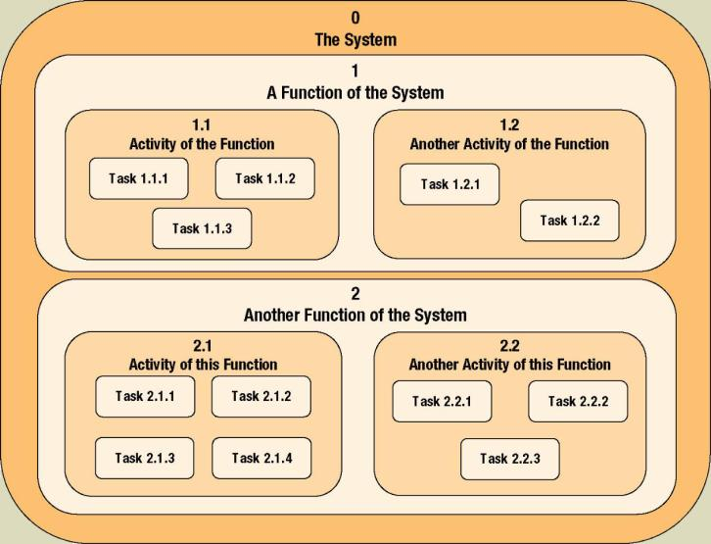
Process Decomposition
Decomposition – the act of breaking a system into sub-components. Each level of abstraction reveals more or less detail.
Notes:
No additional notes

Slide 26
Diverging and Converging Data Flows
Diverging data flow – a data flow that splits into multiple data flows.
Converging data flow – the merger of multiple data flows into a single packet.
Notes:
No additional notes.

Slide 27
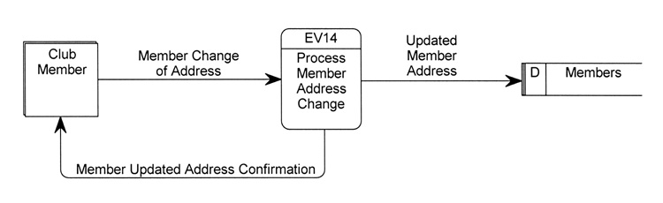
Simple Event DFD
Notes:
No additional notes.

Slide 28
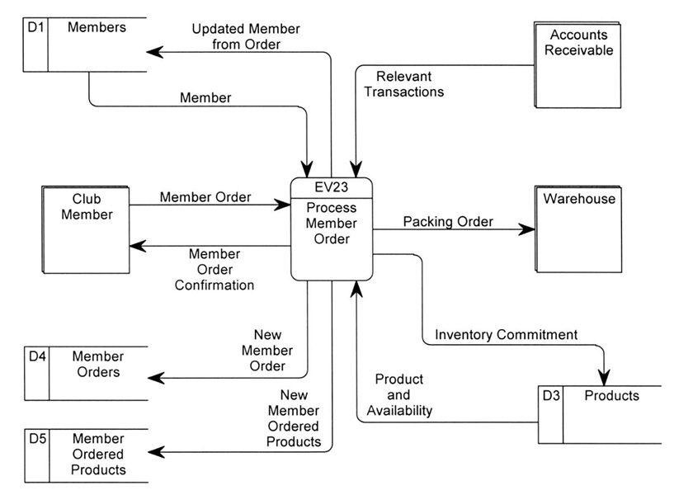
Event DFD (more complex)
Notes:
No additional notes.

Slide 29

Thanks for your attention!
Any Question?

